Slide 1
Causeries on Deep Learning Techniques
Presented by Dr. Jehn-Ruey Jiang
National Central University
Taoyuan City, Taiwan
Notes:
變大、變深、變朦!?
Gets big, deep, and foggy!?

Slide 2
Outline
Big Data
Deep Learning
Deep Learning Techniques
Deep Learning Applications in Industry 4.0
Conclusion

Slide 3
Outline
Big Data
Deep Learning
Deep Learning Techniques
Deep Learning Applications in Industry 4.0
Conclusion

Slide 4
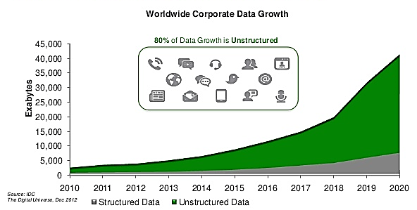
What is “Big Data” ?
… data whose scale, diversity, complexity and fidelity require new architecture, techniques, algorithms, and analytics to manage it and extract value and hidden knowledge from it …
Notes:
多大叫大?大概在50個TB叫做大，超過這個量一般我們用的統計軟體(Excel, SPSS, SAS, R)應該就沒辦法處理
“Big Data” is data whose scale, diversity, and complexity require new architecture, techniques, algorithms, and analytics to manage it and extract value and hidden knowledge from it…
快速消費品（英語：Fast Moving Consumer Goods，即FMCG，簡稱「快消品」或「快銷品」），又作「快速消耗品」。意指銷售速度快、價格相對較低的貨種。也可稱為民生消費性用品(consumer packaged goods; CPG)。儘管快速消費品的絕對利潤相對較低，但因其銷售量巨大，故類似商品的累積利潤可以很高。
K kilo e3 thousand
M Mega e6 million
G Giga e9 billion
T Tera e12 trillion
P Peta e15 quadrillion
E Exa e18 quintillion
Z Zetta e21 sextillion
Y Yotta e24 septillion

Slide 5
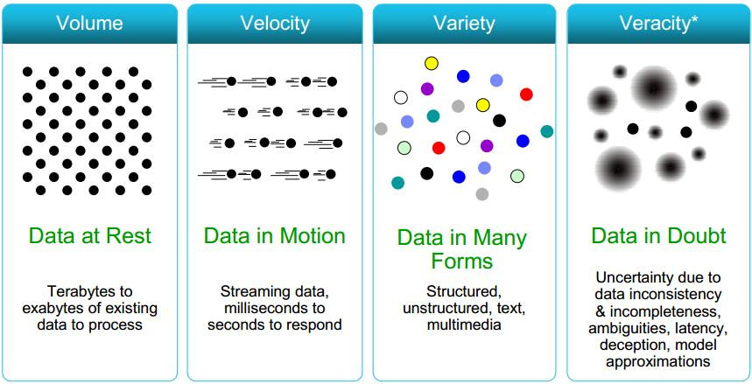
4V’s of Big Data
Source: https://www.slideshare.net/sajjanvsl/final-presentation-45456729
Notes:
https://www.inside.com.tw/2015/02/06/big-data-1-origin-and-4vs
巨量資料的時代，用「大、快、雜、疑」四字箴言帶你認識大數據
2015/2/6
Jewel
你可能有注意到，「大數據（Big Data）」在我們的生活裡已經掀起滔天巨浪，繼雲端運算（Cloud Computing）之後，儼然成為學術界跟科技業中最熱門的潮字（Buzz Word），似乎每家公司都在進行有關的研究，三句不離大數據。究竟大數據是怎麼出現，又代表著什麼意思呢？
大數據（Big Data），資料爆炸的時代
大數據（Big Data）—— 或稱巨量資料
，顧名思義，是指大量的資訊，當資料量龐大到資料庫系統無法在合理時間內進行儲存、運算、處理，分析成能解讀的資訊時，就稱為大數據。
“Big data is data that exceeds the processing capacity of conventional database systems.”
這些巨量資料中有著珍貴的訊息，像是相關性（Unknown Correlation）、未顯露的模式（Hidden Patterns）、市場趨勢（Market Trend），可能埋藏著前所未見的知識跟應用等著被我們挖掘發現；但由於資料量太龐大，流動速度太快，現今科技無法處理分析，促使我們不斷研發出新一代的資料儲存設備及科技，希望從大數據中萃取出那些有價值的資訊。
「Big Data」這個詞最早由 IBM 提出，2010 年才真正開始受到注目，並成為專業用語登上維基百科 ¹，算是「大數據」的正式問世。而在 2012 年時，《紐約時報》的專欄文章「The Age of Big Data²」更是宣告了「大數據時代」的來臨。值得一提的是，大數據並不是什麼新興的概念，事實上，歐洲粒子物理研究中心（CERN）的科學家已經面對巨量資料的問題好幾十年了，處理著每秒上看 PB（Peta Bytes，註：PB = 1,024 TB）的資料量 ³。
TED-Ed 的影片講解 Big Data 概念，簡單又好懂：
https://youtu.be/j-0cUmUyb-Y
一般來說，大數據涵蓋的範圍很廣，定義也各家歧異。最早由 Gartner 公司的分析師 Doug Laney 在 2001 年發表的「3D Data Management: Controlling Data Volume, Velocity, and Variety.」⁴ 一文中挑明了資料處理的三個關鍵挑戰 –– 資料量、速度、多樣性，並在 2012 年 Doug Laney 給予大數據一個全新的定義 ⁵：「大數據是大量、高速、及/或類型多變的資訊資產，它需要全新的處理方式，去促成更強的決策能力、洞察力與最佳化處理。」
"Big data is high volume, high velocity, and/or high variety information assets that require new forms of processing to enable enhanced decision making, insight discovery and process optimization."
於是大部份機構跟公司都將大數據的特性歸類為「3Vs」或「4Vs」–– 資料量 Volume、資料傳輸速度 Velocity、資料類型 Variety，以及後來提出的第四個 V —— 真實性 Veracity。以下整理了 4Vs 簡單的定義跟解釋，可以從這四點切入認識大數據。
Volume 資料量
Data volume: amount of data
以前人們「手動」在表格中記錄、累積出數據；現在數據是由機器、網路、人與人之間的社群互動來生成。你現在正在點擊的滑鼠、來電、簡訊、網路搜尋、線上交易... 都正在生成累積成龐大的數據，因此資料量很容易就能達到數 TB（Tera Bytes，兆位元組），甚至上看 PB（Peta Bytes，千兆位元組）或 EB（Exabytes，百萬兆位元組）的等級。
Velocity 資料輸入輸出速度
Data velocity: speed of data in and out
資料的傳輸流動（data streaming）是連續且快速的，隨著越來越多的機器、網路使用者，社群網站、搜尋結果每秒都在成長，每天都在輸出更多的內容。公司跟機構要處理龐大的資訊大潮向他們襲來，而回應、反應這些資料的速度也成為他們最大的挑戰，許多資料要能即時得到結果才能發揮最大的價值，因此也有人會將 Velocity 認為是「時效性」。
Variety 資料類型
Data variety: range of data types and sources
大數據的來源種類包羅萬象，十分多樣化，如果一定要把資料分類的話，最簡單的方法是分兩類，結構化與非結構化。早期的非結構化資料主要是文字，隨著網路的發展，又擴展到電子郵件、網頁、社交媒體、視訊，音樂、圖片等等，這些非結構化的資料造成儲存（storage）、探勘（mining）、分析（analyzing）上的困難。
Veracity 真實性
Data veracity: uncertainty of data
這個詞由在 Express Scripts 擔任首席數據官（Chief Data Officer, CDO）的 Inderpal Bhandar 在波士頓 大數據創新高峰會（Big Data Innovation Summit） 的演講中提出，認為大數據分析中應該加入這點做考慮，分析並過濾資料有偏差、偽造、異常的部分，防止這些「dirty data」損害到資料系統的完整跟正確性，進而影響決策。
大數據特性，謹記四字箴言：「大、快、雜、疑」
大數據資料量龐「大」（Volume）、變化飛「快」（Velocity），種類繁「雜」（Variety），以及真偽存「疑」（Veracity）。尤其在這資訊大爆炸時代，這些資料變得又多、又快、又雜、又真偽難分。
當然在「大數據」一詞像病毒一樣，侵入我們生活中的各個層面，也有越來越多人提出更多的「V」來解釋大數據，像是 Volatility、Validity、Value、Victory 等，這些分歧的意見在這就不多詳述，只要知道有這些說法、以後聽到別人說到「7Vs」時不要覺得驚訝就行啦！
Wikipedia: Big Data
紐約時報：The Age of Big Data
CERN experiments generating one petabyte of data every second
Laney, Douglas. “The Importance of ‘Big Data’: A Definition”. Gartner. Retrieved 21 June 2012.

Slide 6
Outline
Big Data
Deep Learning
Deep Learning Techniques
Deep Learning Applications in Industry 4.0
Conclusion

Slide 7
Machine Learning: a new problem-solving paradigm in AI
Traditional Programming Paradigm
Ex: Problem: check if a given integer n is even. People make the program according to the rule: if n is divisible by 2, then n is even.
Input (Data)
8
Machine (Computer)
Yes
Output
9
Program
No
Machine Learning Paradigm
Ex: Same Problem. People give a large number of data and associated outputs, and the machine learns (infers) how to solve the problem by making models (e.g., a deep neural network).
8, 9, …..
Input (Data)
Machine
(Computer)
100
Model
(Program)
Yes, No, …
Output
Yes
Adapted from slides of Dr. Pedro Domingos
Notes:
In traditional programming, people make the program or write the program to solve the problem according to rules.
In machine learning, people show data and correct outputs (labels), and the machine (computer) learns how to solve the problem by making models.
If we have the model, then we can solve the problem just like in the traditional programming paradigm that can produce desired outputs for given inputs by programs (models).
Thinking of the following scenario. After the computer is given a million pictures of cats and other animals and associated outputs (yes for cats, no for others), it can correctly answer “yes” or “no” for newly input pictures of cats and others.

Slide 8
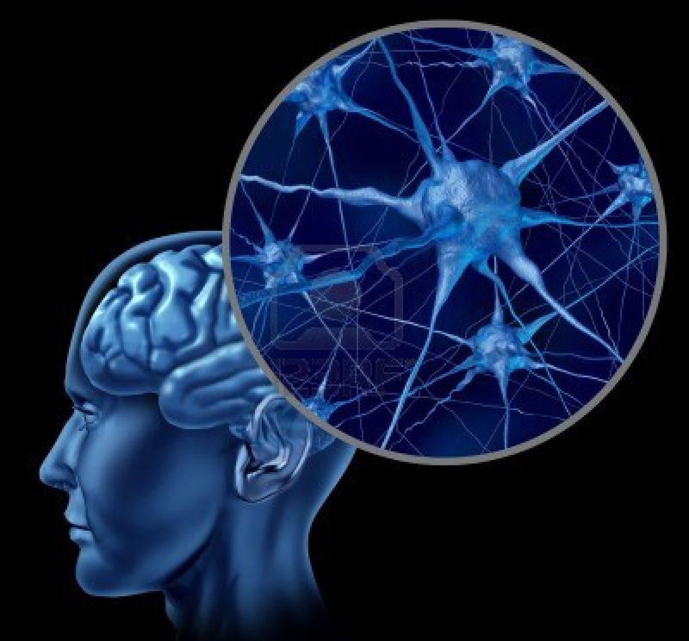
Neural Network in Brain
There are about 10 billion to 100 billion neurons in the human brain.
Each neuron is connected to other up to 100,000 neurons to form a complex neural network.
Notes:
There are about 10 billion to 100 billion (Wiki: 86 billion) neurons in the human brain, as shown in Figure 1. Neurons can receive signals (stimuli) from other neurons by dentites, and after the neuronal cell body collects (aggregates), the weak signal exceeds the threshold (threshold) , The signal will be along the long axon (axon) to the synapse (synapse), the processed signal to other neurons. Each neuron in the human brain is connected to other 10 to 100,000 neurons through synapses to form a complex neural network. Synaptic is a small gap between the end of a neuronal axon and the dendrites of another neuron. To stimulate the external environment, synapses can strengthen or weaken the links between neurons through electrochemical reactions to form the brain Memory and learning

Slide 9
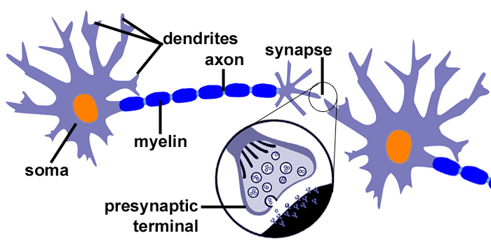
Neuron Structure
Source: http://www.topkeyword.info/105023-synapse-neuron-diagram.htm
Notes:
人類大腦中大約有100億至1000億(Wiki: 860億)個神經元，其結構如圖1所示。神經元可藉由樹突(dentrites)接收來自其他神經元的訊號(刺激)，經過神經元細胞本體(soma, or cell body)匯集(加總)處理之後，弱訊號加總強度超過某個門檻值(threshold)，則訊號會沿著長長的軸突(axon)送到突觸(synapse)，將處理過的訊號送到其他神經元。人類大腦中的每個神經元透過突觸與其他10到10萬個神經元互相連結，形成複雜的神經元網路。突觸是一個神經元軸突的末端跟另一個神經元的樹突之間的小空隙，為適應外界環境的刺激，突觸可以透過電化學反應強化或弱化神經元之間的連結，形成大腦記憶與學習的基礎。

Slide 10
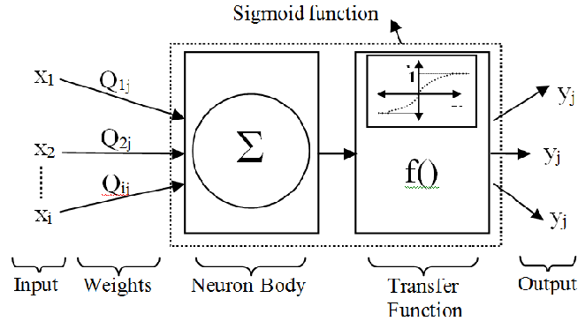
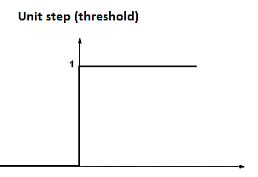
Artificial Neuron
Neuron: y_{j}= b+Σ_{i=1..n}x_{i}×w_{ij} = Σ_{i=0..n}x_{i}×w_{ij}
x₀=1
b
=w_{0j}
w_{1j}
w_{2j}
w_{nj}
x_{n}
Linear Transform
Nonlinear Transform
(Activation Function)
Adapted from: https://www.researchgate.net/publication/260432101_Modeling_of_Driver_Lane_Choice_Behavior_with_Artificial_Neural_Networks_ANN_and_Linear_Regression_LR_Analysis_on_Deformed_Roads

Slide 11
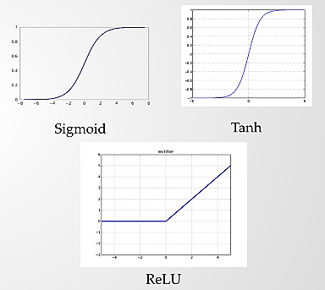
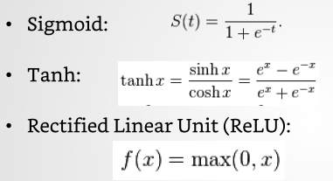
Nonlinear Activation Function
Source: https://www.slideshare.net/GauravMittal68/convolutional-neural-networks-cnn
Notes:
Tanh: Hyperbolic Tangent

Slide 12
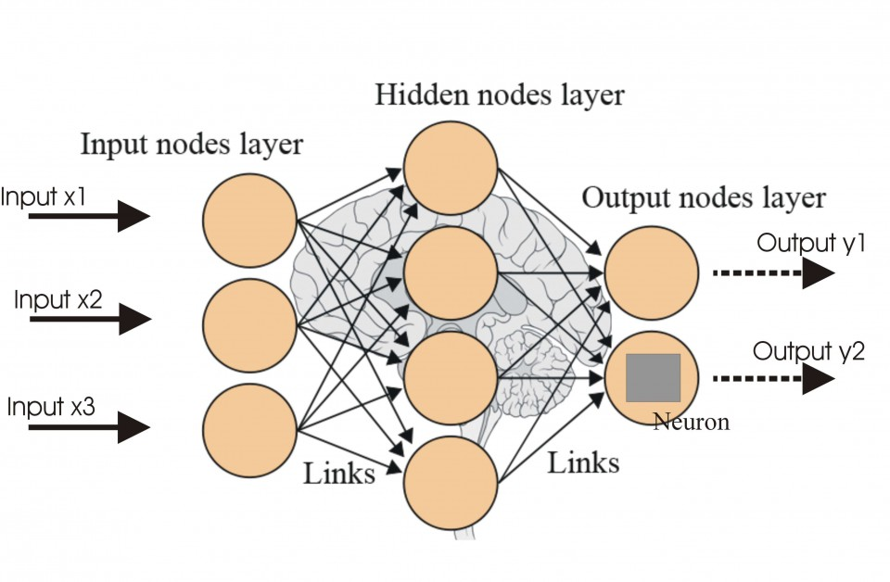
Artificial Neural Network (ANN)
Source: http://futurehumanevolution.com/artificial-intelligence-future-human-evolution/artificial-neural-networks

Slide 13
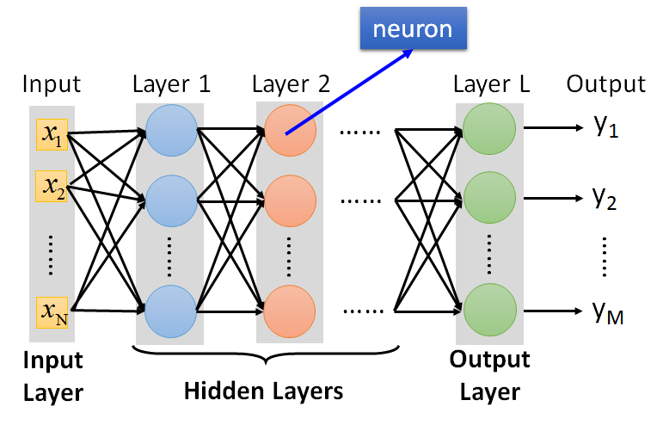
Deep Neural Network (DNN)
Source:http://speech.ee.ntu.edu.tw/~tlkagk/courses/ML_2017/Lecture/DL.pptx
Notes:
Machine Learning:
“Field of study that gives computers the ability to learn without being explicitly programmed.” – Arthur Samuel, IBM, Stanford University, 1959.
“A computer program is said to learn from experience E with respect to some task T and some performance measure P, if its performance on T, as measured by P, improves with experience E.” – Tom Mitchell [Mit97]
“Instead of writing a program by hand, we collect lots of examples that specify the correct output for a given input. A machine learning algorithm then takes these examples and produces a program that does the job.” -- Geoffrey Hinton [Hin 14]

Slide 14
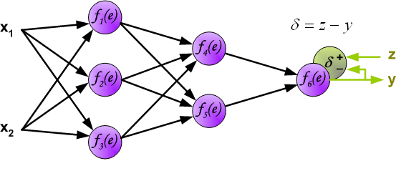
Error Backpropagation Learning Rule
Source: http://galaxy.agh.edu.pl/~vlsi/AI/backp_t_en/backprop.html

Slide 15
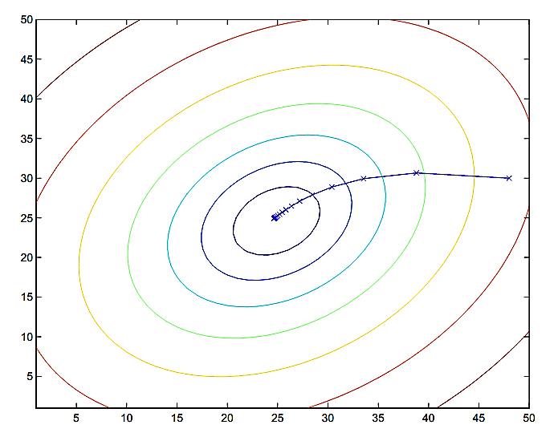
The Cost Function of Errors Is Decreased by Gradient Descent
Source: Andrew Ng, CS229 Lecture Notes, http://cs229.stanford.edu/notes/cs229-notes1.pdf
Notes:
The ellipses shown above are the contours (等高線) of a quadratic function. Also shown is the trajectory taken by gradient descent, which was initialized at (48,30). The x’s in the figure (joined by straight lines) mark the successive values of θ that gradient descent went through.

Slide 16
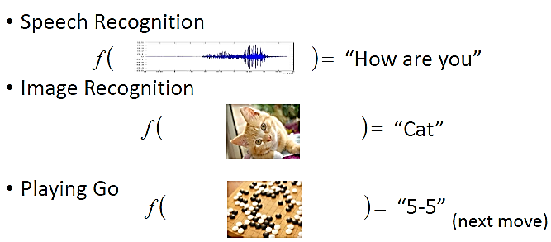
Deep Learning (DL: Machine Learning Using DNN)
Regression
ML_{DNN} (x₁, x₂, …., x_{n}) = (y₁, y₂, …., y_{m})
ML_{DNN}
ML_{DNN}
ML_{DNN}
Adapted from: https://www.slideshare.net/tw_dsconf/ss-62245351?from_action=save
Notes:
Learning methods in neural networks can be broadly classified in three basic types.
- Supervised Learning
- Unsupervised Learning
- Reinforcement Learning
Supervised Learning:-
In supervised learning, both the inputs and the outputs are provided. The network then processes the inputs and compares its resulting outputs against the desired outputs
Errors are then calculated, causing the system to adjust the weights which control the network.
Here a teacher is assume to be present during the learning process.
Unsupervised Learning:-
Here the target output is not presented to the network, Because there is no teacher to present the described patterns.
So the system learns of its own by discovering and adapting to structural features of the input patterns.
Reinforcement Learning:-
In this method, a teacher though available, does not present the expected answer but only indicates if the computed output is correct or incorrect.
The information provided helps the network in its learning process.
Here a reward is given for correct answer computed and a penalty for a wrong answer.

Slide 17
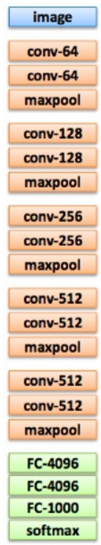
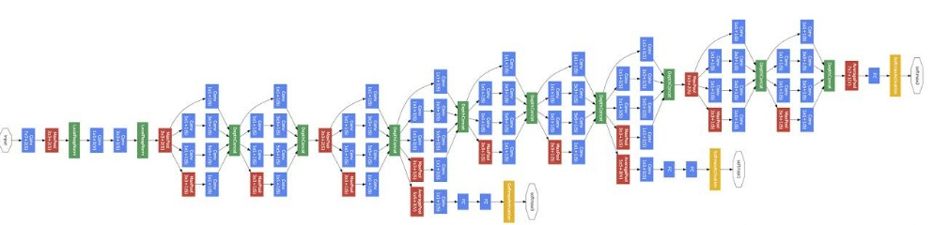
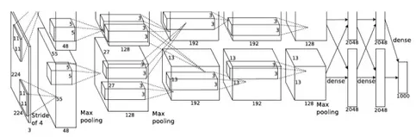
DNN Is Getting Deeper
22 layers
19 layers
8 layers
6.7%
7.3%
16.4%
AlexNet (2012)
VGG (2014)
GoogleNet (2014)
Source: http://speech.ee.ntu.edu.tw/~tlkagk/courses/ML_2017/Lecture/DL.pptx
Notes:
There are several architectures in the field of Convolutional Networks that have a name. The most common are:
LeNet. The first successful applications of Convolutional Networks were developed by Yann LeCun in 1990’s. Of these, the best known is the LeNet architecture that was used to read zip codes, digits, etc.
AlexNet. The first work that popularized Convolutional Networks in Computer Vision was the AlexNet, developed by Alex Krizhevsky, Ilya Sutskever and Geoff Hinton. The AlexNet was submitted to the ImageNet ILSVRC challenge in 2012 and significantly outperformed the second runner-up (top 5 error of 16% compared to runner-up with 26% error). The Network had a very similar architecture to LeNet, but was deeper, bigger, and featured Convolutional Layers stacked on top of each other (previously it was common to only have a single CONV layer always immediately followed by a POOL layer).
ZF Net. The ILSVRC 2013 winner was a Convolutional Network from Matthew Zeiler and Rob Fergus. It became known as the ZFNet (short for Zeiler & Fergus Net). It was an improvement on AlexNet by tweaking the architecture hyperparameters, in particular by expanding the size of the middle convolutional layers and making the stride and filter size on the first layer smaller.
GoogLeNet. The ILSVRC 2014 winner was a Convolutional Network from Szegedy et al. from Google. Its main contribution was the development of an Inception Module that dramatically reduced the number of parameters in the network (4M, compared to AlexNet with 60M). Additionally, this paper uses Average Pooling instead of Fully Connected layers at the top of the ConvNet, eliminating a large amount of parameters that do not seem to matter much. There are also several followup versions to the GoogLeNet, most recently Inception-v4.
VGGNet. The runner-up in ILSVRC 2014 was the network from Karen Simonyan and Andrew Zisserman that became known as the VGGNet. Its main contribution was in showing that the depth of the network is a critical component for good performance. Their final best network contains 16 CONV/FC layers and, appealingly, features an extremely homogeneous architecture that only performs 3x3 convolutions and 2x2 pooling from the beginning to the end. Their pretrained model is available for plug and play use in Caffe. A downside of the VGGNet is that it is more expensive to evaluate and uses a lot more memory and parameters (140M). Most of these parameters are in the first fully connected layer, and it was since found that these FC layers can be removed with no performance downgrade, significantly reducing the number of necessary parameters.
ResNet. Residual Network developed by Kaiming He et al. was the winner of ILSVRC 2015. It features special skip connections and a heavy use of batch normalization. The architecture is also missing fully connected layers at the end of the network. The reader is also referred to Kaiming’s presentation (video, slides), and some recent experiments that reproduce these networks in Torch. ResNets are currently by far state of the art Convolutional Neural Network models and are the default choice for using ConvNets in practice (as of May 10, 2016). In particular, also see more recent developments that tweak the original architecture from Kaiming He et al. Identity Mappings in Deep Residual Networks (published March 2016).
AlexNet is the name of a convolutional neural networkrunning on GPUs implemented in CUDA, which competed in the ImageNet Large Scale Visual Recognition Challenge^{[1]} in 2012. AlexNet was designed by Alex Krizhevsky.
Alexnet contained only 8 layers, first 5 were convolutional layers followed by fully connected layers.^{[2]}
The ImageNet project is a large visual database designed for use in visual object recognition software research. As of 2016, over ten million URLs of images have been hand-annotated by ImageNet to indicate what objects are pictured; in at least one million of the images, bounding boxes are also provided.[1] The database of annotations of third-party image URL's is freely available directly from ImageNet; however, the actual images are not owned by ImageNet.[2] Since 2010, the ImageNet project runs an annual software contest, the ImageNet Large Scale Visual Recognition Challenge (ILSVRC), where software programs compete to correctly classify and detect objects and scenes.

Slide 18
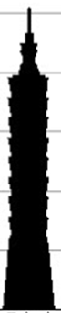
DNN Is Getting Deeper
152 layers
101 layers
22 layers
19 layers
3.57%
8 layers
7.3%
6.7%
16.4%
AlexNet (2012)
VGG
(2014)
GoogleNet
(2014)
Residual Net
(2015)
Taipei
101
Source: http://speech.ee.ntu.edu.tw/~tlkagk/courses/ML_2017/Lecture/DL.pptx
Notes:
169層

Slide 19
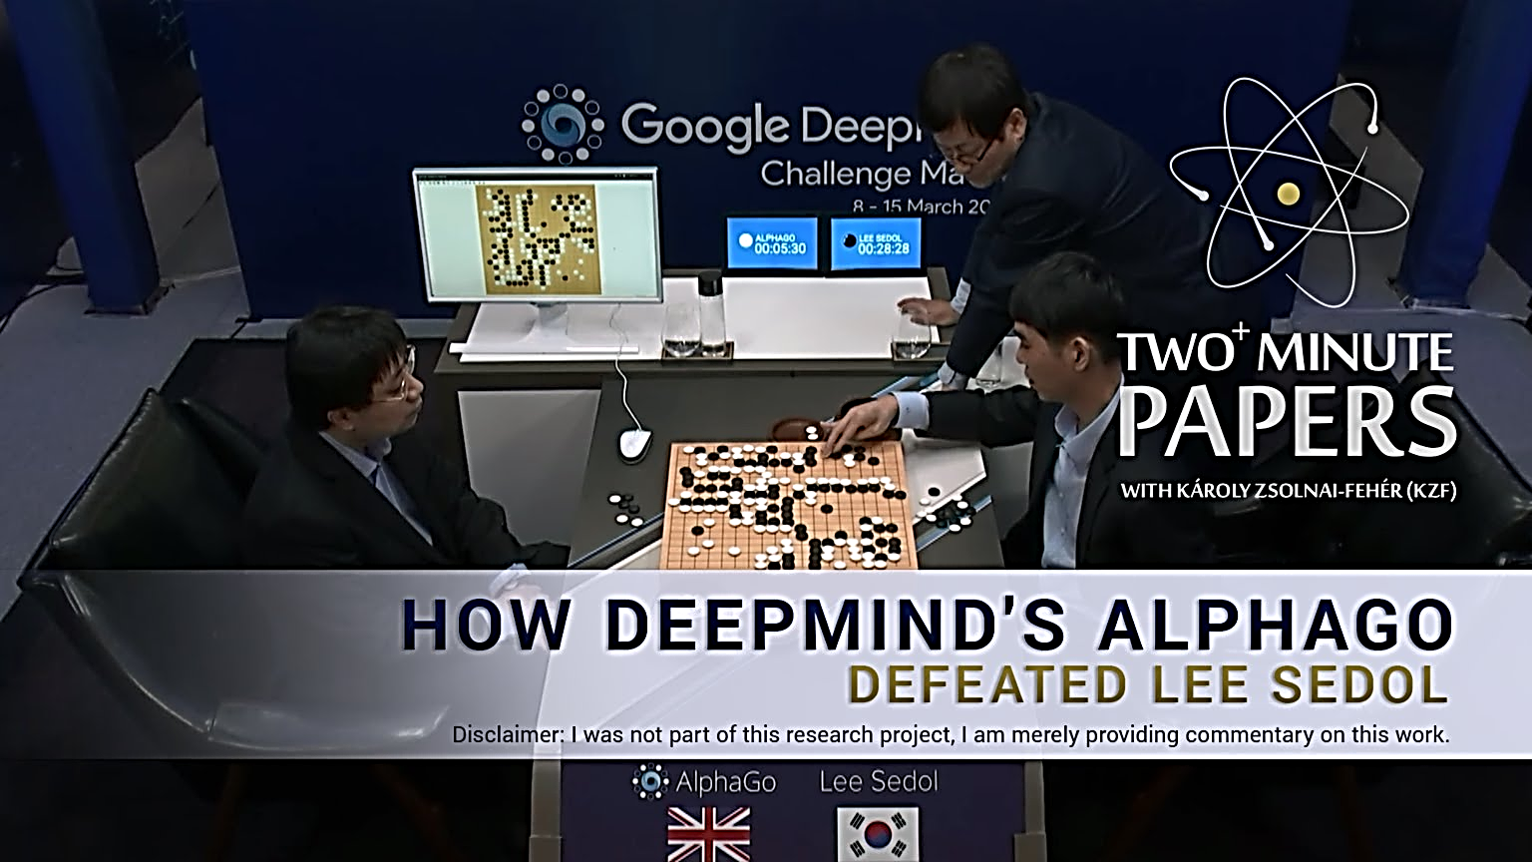
Source: https://www.youtube.com/watch?v=a-ovvd_ZrmA
Notes:
李世乭（韓語：이세돌，1983年3月2日－），韓國圍棋九段棋士，成長於韓國全羅南道新安郡飛禽島，所以又被稱為「飛禽島少年」。又因其出道初期於韓國國內戰績顯赫，也被稱為「不敗少年」。
「乭」非中文漢字，而是朝鮮漢字，本義「石」，發音「dol」
採取5局賽制，最後比數4:1，第四局Alphago亂下…..
升級版Alpha Go化名Master挑戰圍棋高手，創下60連勝
圍棋界最近因網上一位名為「Master」的棋手而風雲變色。這位神秘高手連日來在大陸著名圍棋對弈平台奕城網和騰訊的野狐圍棋與來自中日韓的九段高手以及一眾名將對弈，一口氣連勝60局。Master的手下敗將分別包括日本圍棋第一人井山裕太、號稱「中國圍棋第一人」的柯潔、中國「棋聖」聶衛平以及韓國高手朴廷桓。連日來的勝利都讓外界紛紛猜測這神秘棋手的身份。
在2017年1月4日晚間戰勝了中國籍世界冠軍古力之後，這位神秘棋手就揭曉了身份：在去年(2016)3月擊敗韓國棋手李世石，引起一陣轟動的圍棋AI Alpha Go。Master於對戰聊天室宣佈「我是 AlphaGo 的黃博士」，正式表明身份。Master所指的黃博士為來自台灣的黃士傑博士，是Alpha Go的核心開發成員，亦是一位業餘棋手。在去年與南韓棋手李世石的博弈以及這次和云云高手的挑戰中，黃士傑就代為落子。

Slide 20
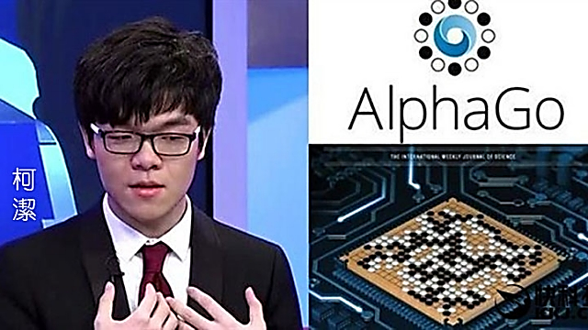
Source: http://hk.apple.nextmedia.com/realtime/china/20170407/56533245
Notes:
AlphaGo完勝 終戰柯潔第209手投子認輸
2017-05-27 14:53聯合報 記者戴瑞芬╱即時報導
柯潔與AlphaGo的圍棋三番戰最終戰，從上午十點開戰，鏖戰到下午兩點，柯潔下至第209手最後還是投子認輸，沒能上演逆轉勝奇蹟，人工智慧的下棋機器人AlphaGo以三戰三勝完敗排名第一的世界圍棋冠軍。
新浪報導，這場棋局是柯潔五天內第三次站在AlphaGo面前，柯潔在第一手就思考了兩分鐘，接下來長考還在繼續，到第31手，他耗時已經達37分鐘，而AlphaGo只用了12分鐘半。
比賽才過45分鐘。到場講棋的棋聖聶衛平就表示，「AlphaGo已經贏了，可以收子了。」
搜狐報導，如果不知道是AlphaGo在下黑棋，估計大多數人都會認為黑棋的構思是「胡鬧」，不過現在AlphaGo如同圍棋之神在指點人類，它超強的全域結合力，讓棋手重新審視這個局部與全域的關聯，白棋如何定型確實是很頭疼的問題，稍不注意，就會陷入全域的被動。
去年當南韓棋聖李世石被AlphaGo打敗時，柯潔還特地發微博叫陣，「AlphaGo贏得了李世石但贏不了我」。因此今年，柯潔與AlphaGo的人機大戰舉世矚目，不過，第一盤歷時4小時25分落幕，柯潔完全被壓制，最後慘輸；第二盤柯潔只在半局就棄子認輸，當時柯潔被問第三盤棋怎麼下時？柯潔的回答很乾脆「我不喜歡安樂死」，表示會全力以赴，下出讓自己滿意的棋。可惜柯潔壯志未酬。
年僅20的柯潔，已經是三次世界大賽冠軍，如此成績無人匹敵，但面對機器人，柯潔還是一局都贏不了。
柯潔之後，還有人能戰勝AlphaGo嗎？終戰落幕，搜狐報導，或許想贏AlphaGo一盤很難，但挑戰極限之所以能夠偉大，不是因為結果，而是因為無畏。

Slide 21
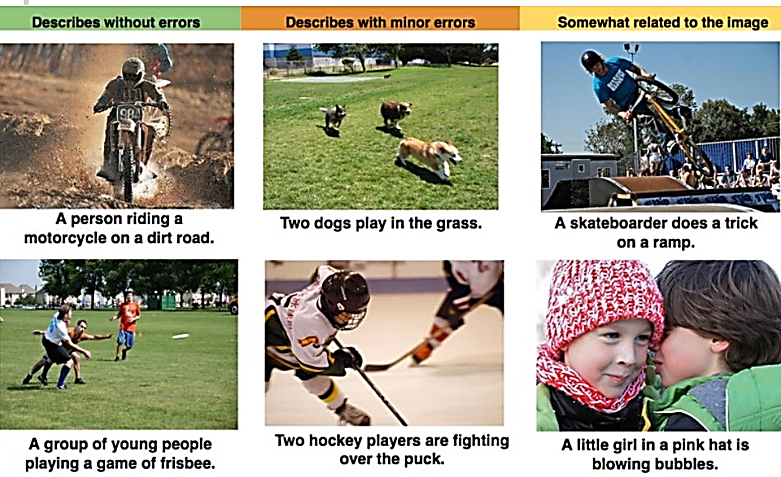
Image Captioning
Source: https://www.slideshare.net/tw_dsconf/ss-70083878?from_action=save

Slide 22
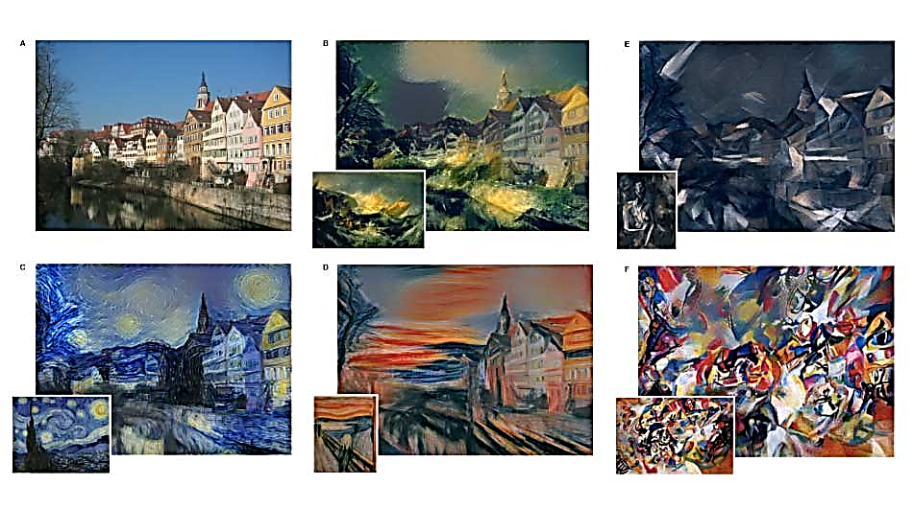
Arts
Source: http://arxiv.org/abs/1508.06576
Notes:
A (Photo: Andreas Praefcke).
The painting that provided the style for the respective generated image
is shown in the bottom left corner of each panel.
B The Shipwreck of the Minotaur by J.M.W. Turner, 1805. 英國透納
C The Starry Night by Vincent van Gogh, 1889. 荷蘭 梵谷
D Der Schrei by Edvard Munch, 1893. 挪威 慕克 吶喊
E Femme nue assise by Pablo Picasso, 1910. 西班牙裔法國 畢卡索
F Composition VII by Wassily Kandinsky, 1913. 俄羅斯 肯汀斯基

Slide 23
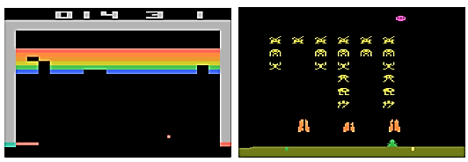
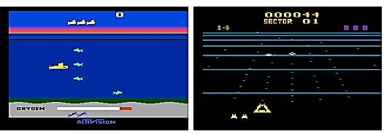
Video Games
Source: http://arxiv.org/pdf/1312.5602v1.pdf

Slide 24
Outline
Big Data
Deep Learning
Deep Learning Techniques
Deep Learning Applications in Industry 4.0
Conclusion

Slide 25
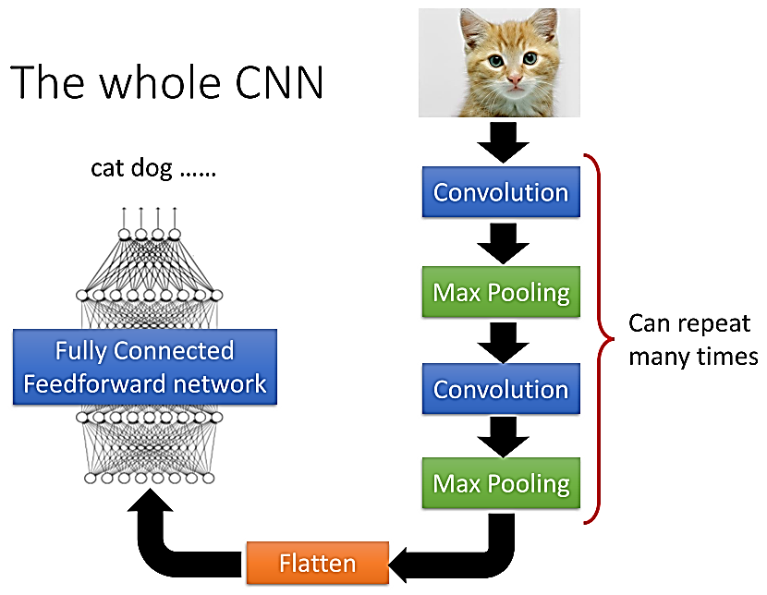
Convolutional Neural Network
Source: http://speech.ee.ntu.edu.tw/~tlkagk/courses/ML_2016/Lecture/CNN%20(v2).pdf

Slide 26
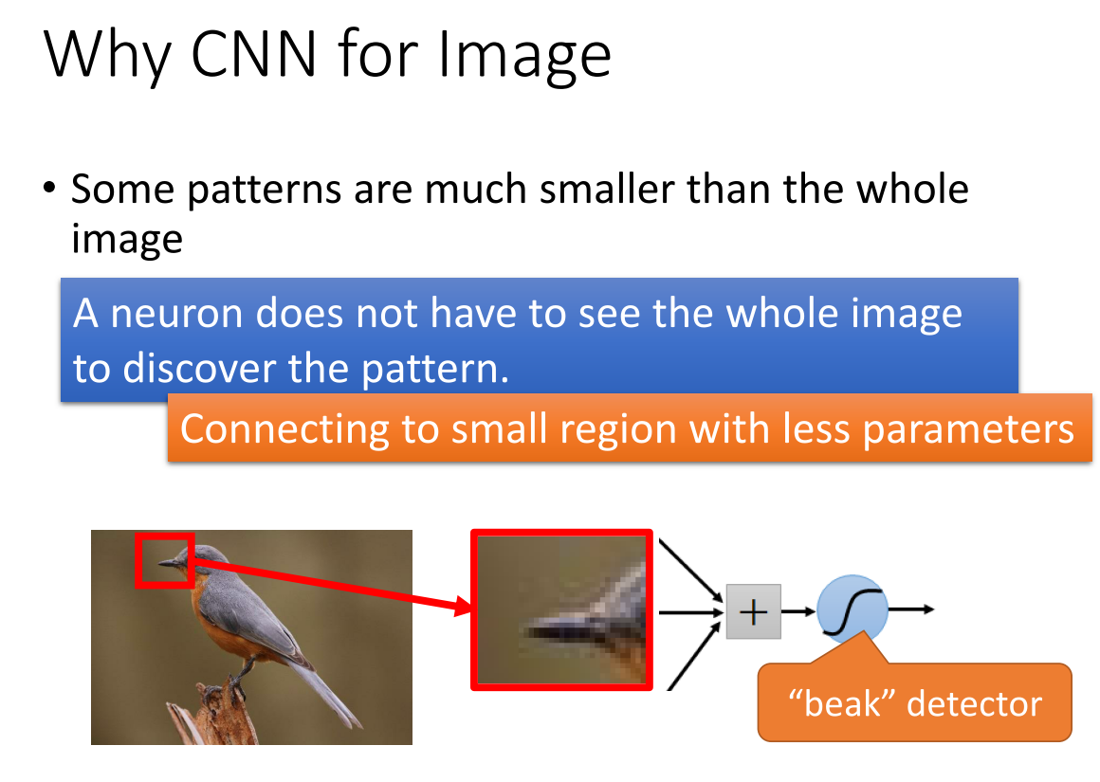
Source: http://speech.ee.ntu.edu.tw/~tlkagk/courses/ML_2016/Lecture/CNN%20(v2).pdf

Slide 27
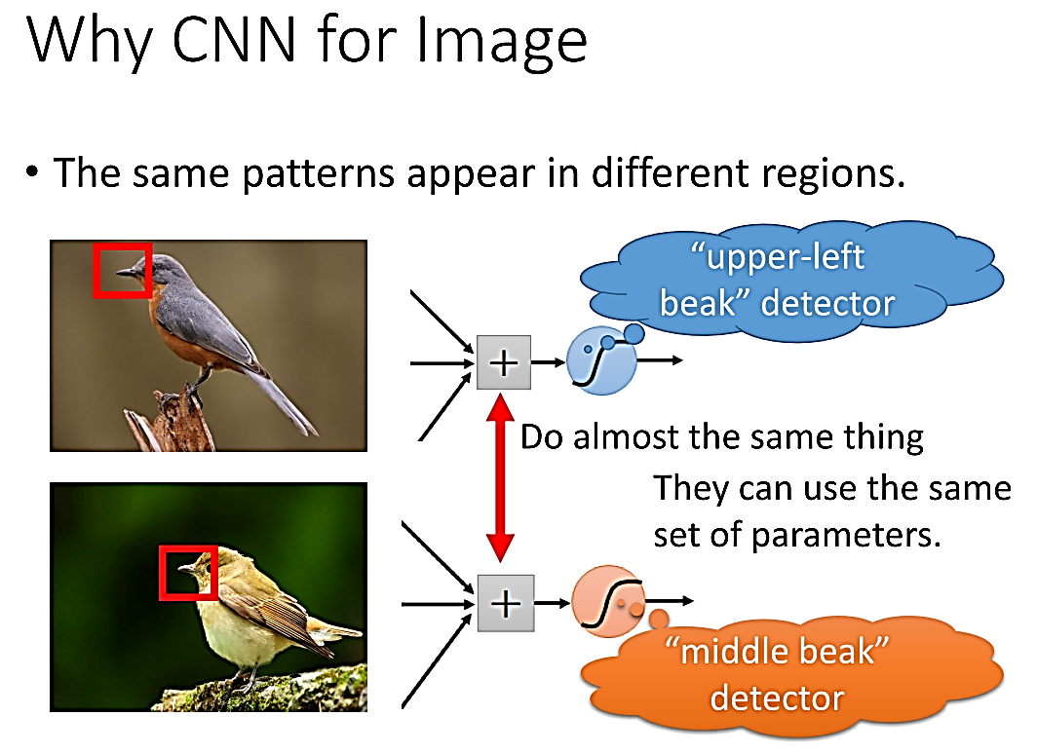
Source: http://speech.ee.ntu.edu.tw/~tlkagk/courses/ML_2016/Lecture/CNN%20(v2).pdf

Slide 28
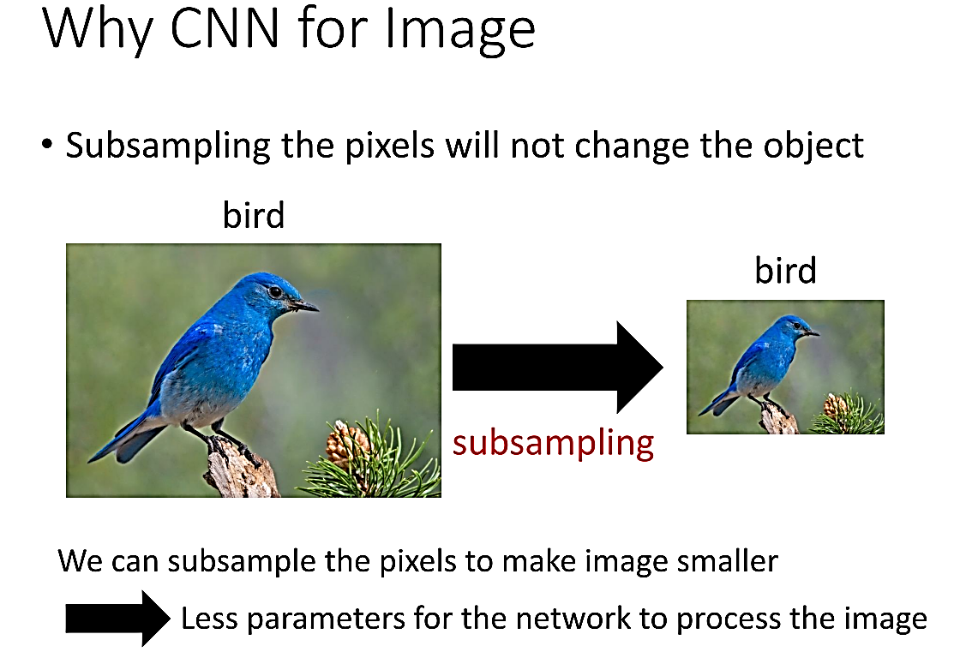
Source: http://speech.ee.ntu.edu.tw/~tlkagk/courses/ML_2016/Lecture/CNN%20(v2).pdf

Slide 29
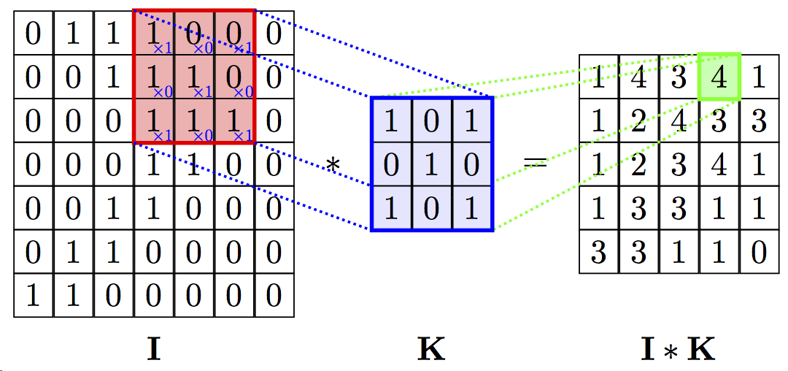

Convolution
Notes:
I: Image
K: kernel or filter
I*K: Convolved Feature

Slide 30
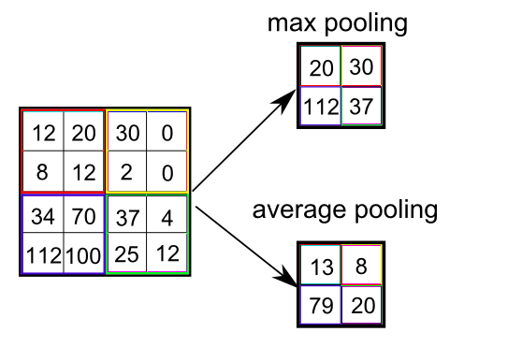
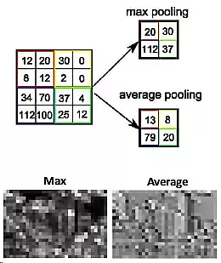
Pooling

Slide 31
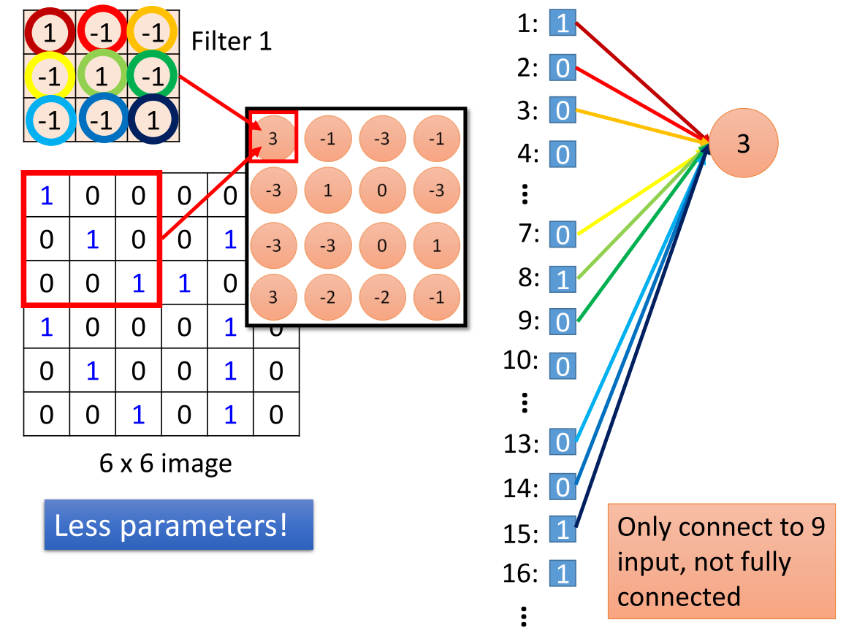
Source: http://speech.ee.ntu.edu.tw/~tlkagk/courses/ML_2016/Lecture/CNN%20(v2).pdf

Slide 32
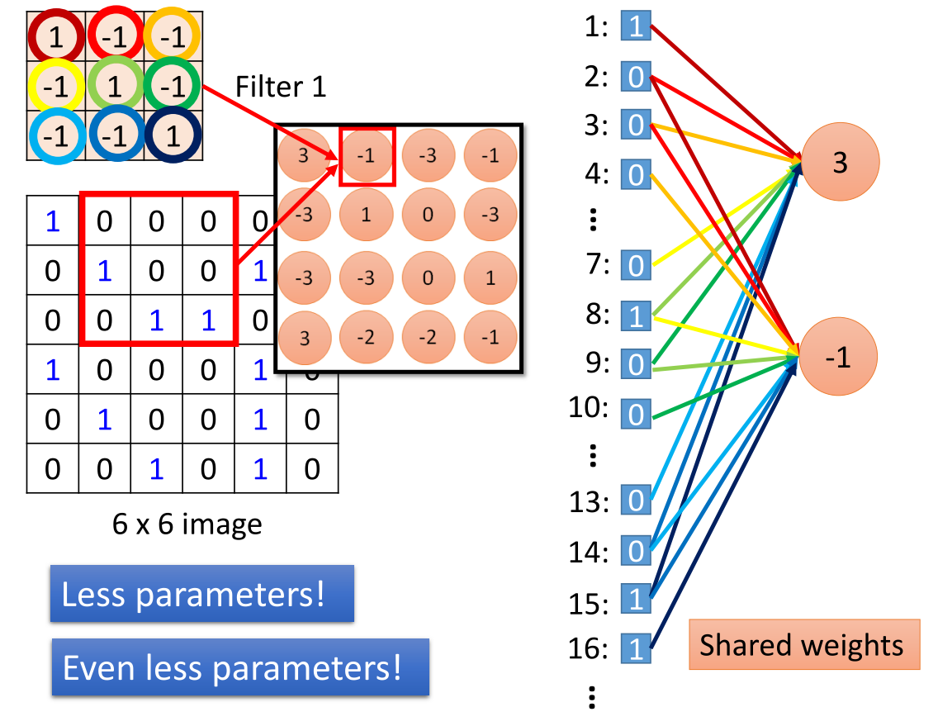
Source: http://speech.ee.ntu.edu.tw/~tlkagk/courses/ML_2016/Lecture/CNN%20(v2).pdf

Slide 33
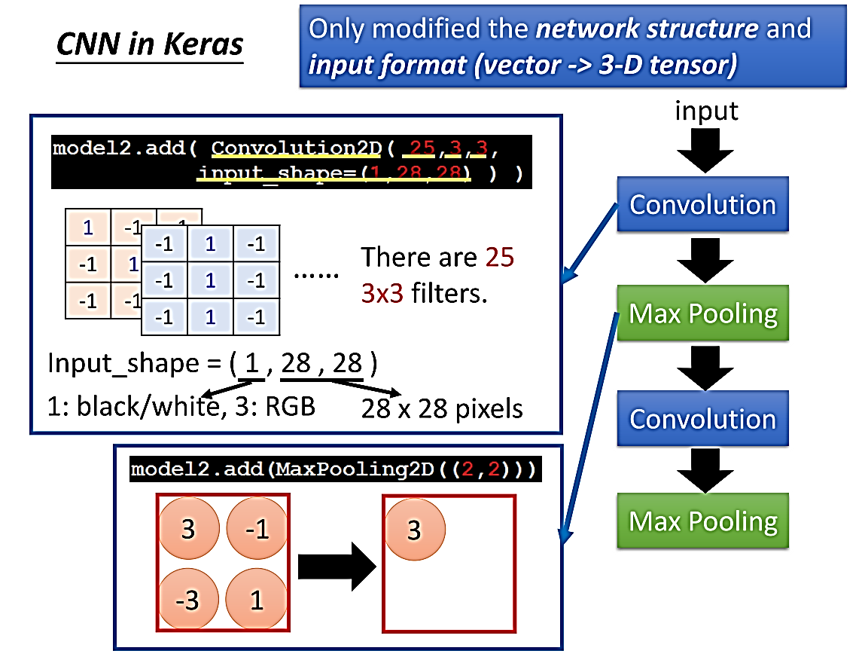
Source: http://speech.ee.ntu.edu.tw/~tlkagk/courses/ML_2016/Lecture/CNN%20(v2).pdf

Slide 34
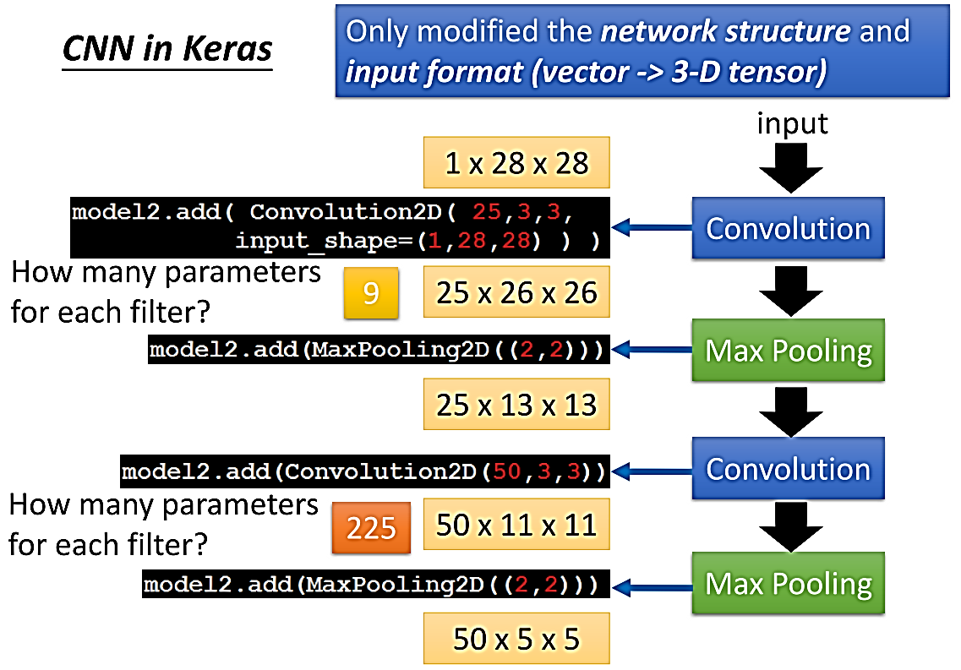
Source: http://speech.ee.ntu.edu.tw/~tlkagk/courses/ML_2016/Lecture/CNN%20(v2).pdf

Slide 35
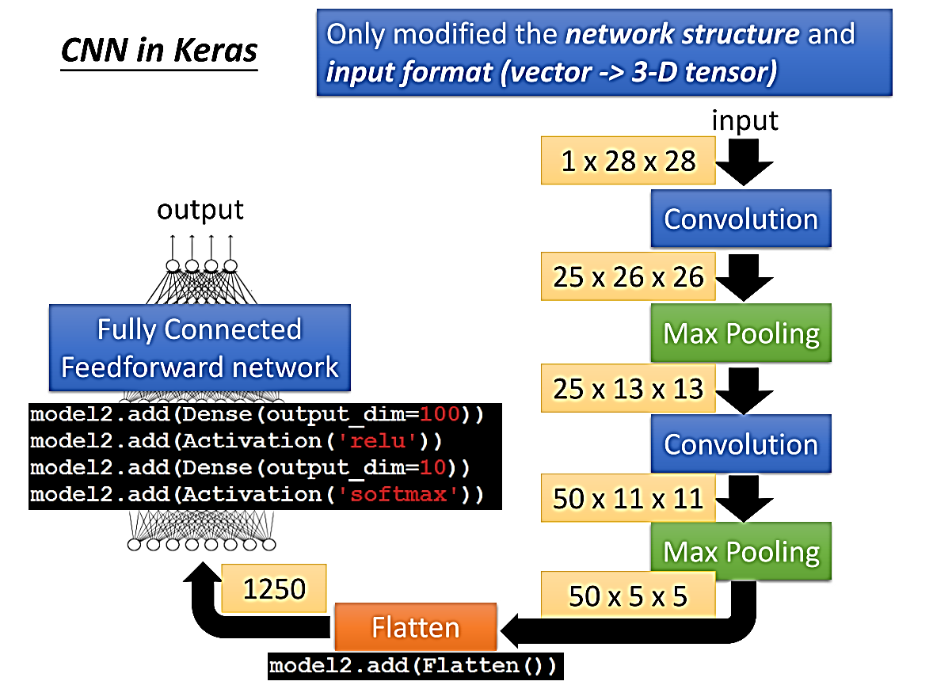
Source: http://speech.ee.ntu.edu.tw/~tlkagk/courses/ML_2016/Lecture/CNN%20(v2).pdf

Slide 36
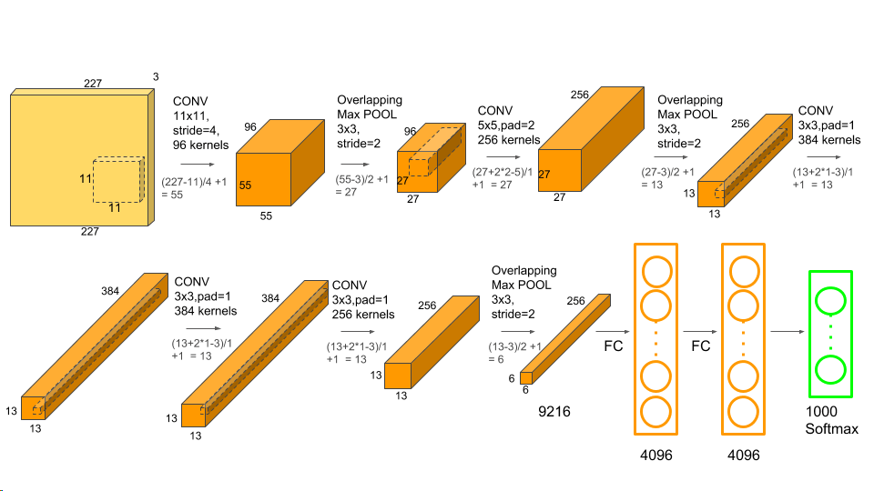

CNN Example: AlexNet by Alex Krizhevsky
The champion of 2012 ImageNet Large Scale Visual Recognition Challenge (ILSVRC). *ImageNet is a large visual database containing more than 14 million images which have been hand-annotated to indicate what objects are pictured.
Notes:
Alex Krizhevsky (亞力克斯克里哲福斯基): University of Toronto Canada (born in Ukraine, raised in Canada)
AlexNet is the name of a convolutional neural network, designed by Alex Krizhevsky,^{[1]}and published with Ilya Sutskever and Krizhevsky's PhD advisor Geoffrey Hinton,^{[2][3]}who was originally resistant to the idea of his student.^{[1][4]}
AlexNet became the pioneering “deep” CNN that won the competition with 84.6% accuracy, while the 2nd-place model (which still used the traditional techniques in LeNet instead of deep architectures), only achieved 73.8% accuracy rate.
The ImageNet project is a large visual database designed for use in visual object recognition software research. More than 14 million^{[1][2]} images have been hand-annotated by the project to indicate what objects are pictured and in at least one million of the images, bounding boxes are also provided.
ImageNet contains more than 20,000 categories^{[2]} with a typical category, such as "balloon" or "strawberry", consisting of several hundred images.
Since 2010, the ImageNet project runs an annual software contest, the ImageNet Large Scale Visual Recognition Challenge (ILSVRC), where software programs compete to correctly classify and detect objects and scenes.
On 30 September 2012, a convolutional neural network (CNN) called AlexNet^{[7]}achieved a top-5 error of 15.3% in the ImageNet 2012 Challenge, more than 10.8 percentage points lower than that of the runner up. This was made feasible due to the utilization of Graphics processing units (GPUs) during training,^{[7]} an essential ingredient of the deep learning revolution. According to The Economist, "Suddenly people started to pay attention, not just within the AI community but across the technology industry as a whole."^{[4][8][9]}
Padding比較常見的操作是在輸入矩陣最外圍補上一圈0之後，再參與卷積運算。這樣，我們就可以自行控制輸出矩陣的大小。下面列舉幾個常見的Padding方式：
Arbitrary Padding在輸入圖像周圍填充0，使輸出矩陣尺寸大於輸入尺寸。例如，下圖對5 × 55×5的輸入矩陣外圍補上2圈0後，與4 × 44×4 的捲積核做卷積運算，最終得到 6 × 66×6 的輸出矩陣的過程。
還有一種是Full Padding，卷積核從輸入矩陣左角第一個方塊開始，依次移動到右下角的最後一個方塊。

Slide 37
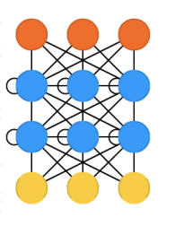

Recurrent Neural Network（RNN）

Slide 38


Long Short-Term Memory (LSTM) -- A special type of RNN
Notes:
在深度學習中，RNN的目的在於處理與時間序列有關的資料，例如預測句子的下一個詞是甚麼，與一般神經網路不同的是，強調資料的輸入存在相依性，而不是互相獨立的，因此透過網路中的循環特性，讓當前的輸出必須考慮到上一次的輸出結果，就像是網路中有了「記憶」，會依照過往的記憶決定接下來的輸出結果，如圖 6，將一個RNN展開，可看成時序資料由左往右輸入，$x_{0}$,$x_{1}$,$x_{2}$,…,$x_{t}$代表每個時序的輸入資料，$h_{0}$,$h_{1}$,$h_{2}$,…,$h_{t}$代表每個時序的輸出，t表示輸入的時間。
理論上此架構可以處理任何長度的時序性資料，然而實際上在訓練時所用的倒傳遞演算法，會讓此架構產生梯度爆炸(Gradient Exploding)或是梯度消失(Gradient Vanishing)的問題，即隨著時序的增加，權重的更新大到無法處理的地步，稱為梯度爆炸；權重的更新小到趨近於0，稱為梯度消失，使得神經網路只記得最近發生的事情，而時間較久前的結果已經遺忘。
長短期記憶(Long Short-Term Memory，LSTM)
LSTM是一種時間遞歸神經網路，由於傳統的RNN存在梯度消失問題，在進行梯度下降法時，修正量隨著時間傳遞而衰減，導致參數無法被更新，神經網路不能訓練到最好，但是LSTM能做到更好地掌握長時序的依賴。Hochreiter與Schmidhuber[5]提出了LSTM這個架構來解決此問題，與RNN相比複雜許多，包含有三個閘：輸入閘(Input Gate)、輸出閘(Output Gate)、及遺忘閘(Forget Gate)，並有一記憶單元(Memory Cell)，以閘(Gate)的概念，去控制訊息加入到記憶單元和從記憶單元中移除，因此這三個開關是用來保護和控制記憶狀態，他們有各自的權重，會依據輸入資料經過權重計算之後，來決定每個開關的開啟或關閉。
在標準的RNN中，重複使用的神經元只是一個非常簡單的結構，例如一個 tanh層，如圖 7。

Slide 39
Outline
Big Data
Deep Learning
Deep Learning Techniques
Deep Learning Applications in Industry 4.0
Conclusion

Slide 40
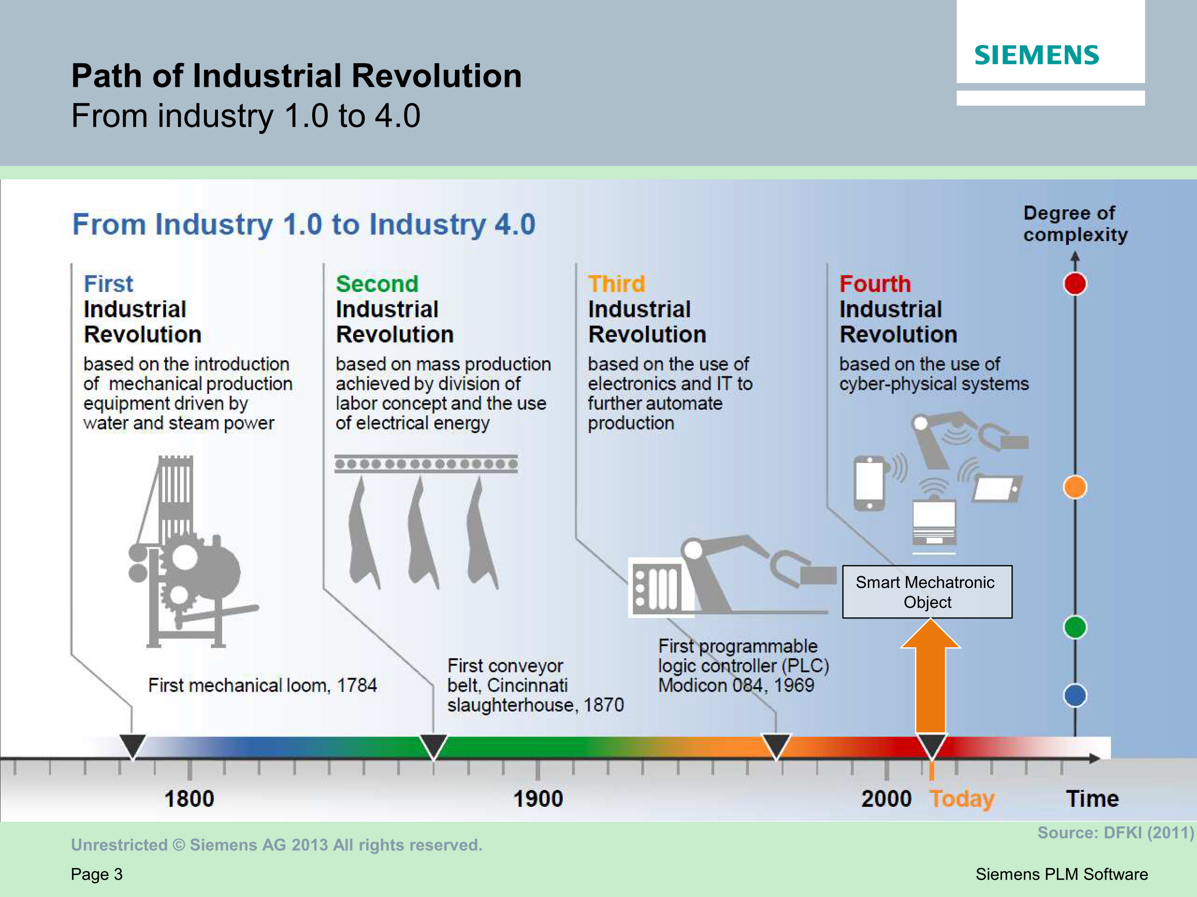
Source: Siemens PLM Software
Notes:
As you have known, Industry 4.0 or Industry 4th revolution is a concept proposed by German government. It is said there are four industrial revolutions in history. The first industrial revolution happened about 230 years ago; it is based on mechanical production driven by steam power. The second happened about 150 years ago; it is based on mass production driven by electrical power. The third happened about 50 years ago. It is based on automative production using IT technology. The fourth is happening now. It is based on smart production using CPS.
工業物聯網(Industrial Internet of Things, IIoT)是實現德國政府所提工業4.0 (Industry 4.0, I4.0)[1]策略的核心技術。如文獻[2]中所描述:「工業4.0一詞最早是在 2011 年的漢諾瓦工業博覽會提出。2012年10月由羅伯特·博世有限公司的 Siegfried Dais 及利奧波第那科學院的孔翰寧組成的工業4.0工作小組，向德國聯邦政府提出了工業4.0的實施建議。2013年4月8日的漢諾瓦工業博覽會中，工業4.0工作小組提出了最終報告」。如圖1所示，工業4.0 的策略願景是藉由網實融合系統(Cyber-Physical System, CPS)[3]或網實融合生產系統(Cyber-Physical Production System, CPPS)[4]建構智慧工廠(Smart Factory)達成第四次工業革命。這是繼利用蒸汽動力生產的第一次工業革命、使用電力為基礎進行生產線式大量生產的第二次工業革命、及使用電子裝置及資訊技術以增進工業自動化製造的第三次工業革命之後的革命(revolution)或演進(evolution)。除了德國政府提出的工業4.0策略之外，還有許多其他國家政府或機構也提出類似的策略或概念[5]，包括台灣的生產力4.0 (Productivity 4.0)、美國再工業化(Reindustrialization)、中國製造2025、IBM的智慧地球（Smart Planet）、思科（Cisco）的萬物聯網（Internet of Everything, IoE）、奇異電子（GE）的工業網際網路（Industrial Internet）、阿里巴巴的C2B商業模式、海爾的互聯工廠與智慧家庭，如[5]所提到的，這些策略或概念講的都是同一件事，只是從不同角度切入與實踐而已。

Slide 41
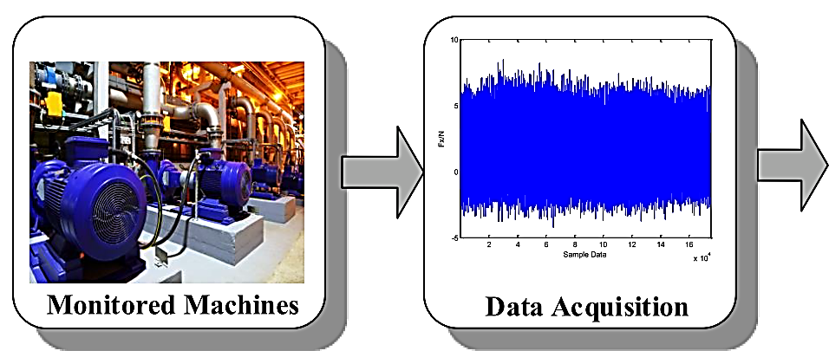
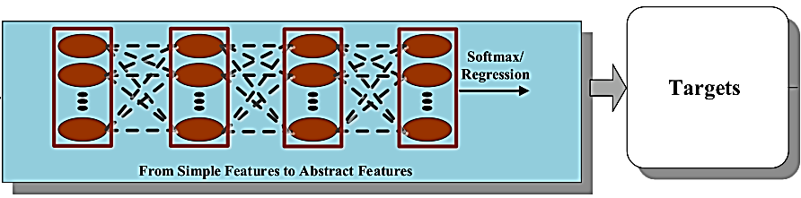
MHMS (Machine Health Monitoring System) for Smart Manufacturing
Deep Learning Based (E2E) MHMS
Source: Zhao, Rui, et al., "Deep Learning and Its Applications to Machine Health Monitoring: A Survey," 2016.
Notes:
Softmax函數，或稱歸一化指數函數^{[1]:198}，是邏輯函數的一種推廣。它能將一個含任意實數的K維的向量 {\displaystyle \mathbf {z} } 的「壓縮」到另一個K維實向量 {\displaystyle \sigma (\mathbf {z} )} 中，使得每一個元素的範圍都在(0, 1)之間，並且所有元素的和為1
In mathematics, the softmax function, or normalized exponential function,^{[1]:198} is a generalization of the logistic function that "squashes" a K-dimensional vector {\displaystyle \mathbf {z} } of arbitrary real values to a K-dimensional vector {\displaystyle \sigma (\mathbf {z} )} of real values in the range (0, 1) that add up to 1.

Slide 42
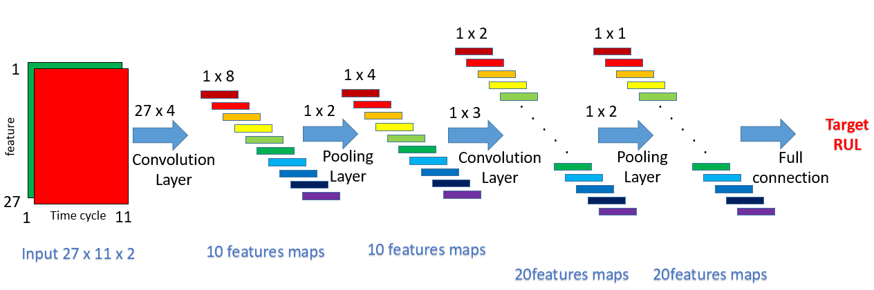
Remaining Useful Life (RUL) Estimation with Enhanced Convolutional Neural Network (ECNN)
Notes:
FD002 has 27 features
27 features x 11 time cycles x 2 times (22 time cycles) (like as RG layers in images)

Slide 43
Remaining Useful Life (RUL) Estimation with Long Short-Term Memory (LSTM) Recurrent Neural Network (RNN)
Notes:
在深度學習中，RNN的目的在於處理與時間序列有關的資料，例如預測句子的下一個詞是甚麼，與一般神經網路不同的是，強調資料的輸入存在相依性，而不是互相獨立的，因此透過網路中的循環特性，讓當前的輸出必須考慮到上一次的輸出結果，就像是網路中有了「記憶」，會依照過往的記憶決定接下來的輸出結果，如圖 6，將一個RNN展開，可看成時序資料由左往右輸入，$x_{0}$,$x_{1}$,$x_{2}$,…,$x_{t}$代表每個時序的輸入資料，$h_{0}$,$h_{1}$,$h_{2}$,…,$h_{t}$代表每個時序的輸出，t表示輸入的時間。
理論上此架構可以處理任何長度的時序性資料，然而實際上在訓練時所用的倒傳遞演算法，會讓此架構產生梯度爆炸(Gradient Exploding)或是梯度消失(Gradient Vanishing)的問題，即隨著時序的增加，權重的更新大到無法處理的地步，稱為梯度爆炸；權重的更新小到趨近於0，稱為梯度消失，使得神經網路只記得最近發生的事情，而時間較久前的結果已經遺忘。
長短期記憶(Long Short-Term Memory，LSTM)
LSTM是一種時間遞歸神經網路，由於傳統的RNN存在梯度消失問題，在進行梯度下降法時，修正量隨著時間傳遞而衰減，導致參數無法被更新，神經網路不能訓練到最好，但是LSTM能做到更好地掌握長時序的依賴。Hochreiter與Schmidhuber[5]提出了LSTM這個架構來解決此問題，與RNN相比複雜許多，包含有三個閘：輸入閘(Input Gate)、輸出閘(Output Gate)、及遺忘閘(Forget Gate)，並有一記憶單元(Memory Cell)，以閘(Gate)的概念，去控制訊息加入到記憶單元和從記憶單元中移除，因此這三個開關是用來保護和控制記憶狀態，他們有各自的權重，會依據輸入資料經過權重計算之後，來決定每個開關的開啟或關閉。
在標準的RNN中，重複使用的神經元只是一個非常簡單的結構，例如一個 tanh層，如圖 7。

Slide 44
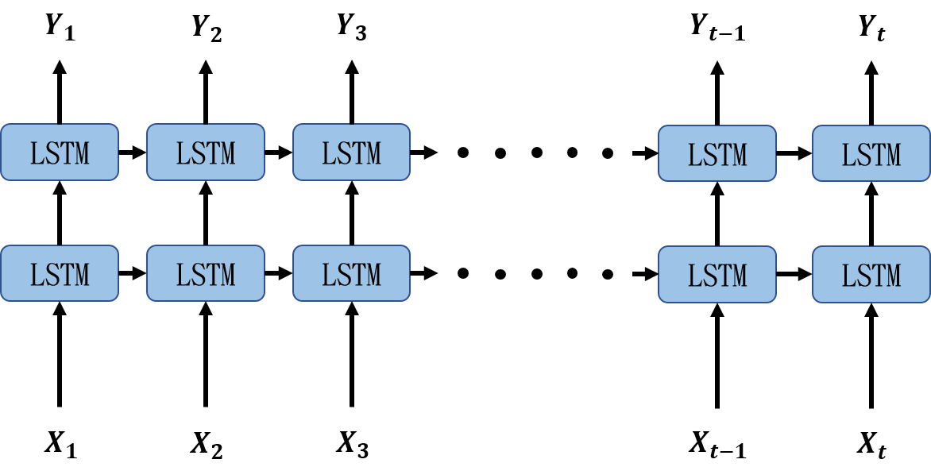
Remaining Useful Life (RUL) Estimation with Long Short-Term Memory (LSTM) Recurrent Neural Network (RNN) (Con’t)
Notes:
FD001 and FD003 have 24 features
兩層的LSTM作為隱藏層，如圖，每個藍色方塊表示一層LSTM結構(64個神經元)，時序資料由左往右輸入，$X_{1}$,$X_{2}$…$X_{t}$代表每個時序的輸入資料，$Y_{1}$,$Y_{2}$…$Y_{t}$代表每個時序的輸出，t表示輸入的時間。

Slide 45
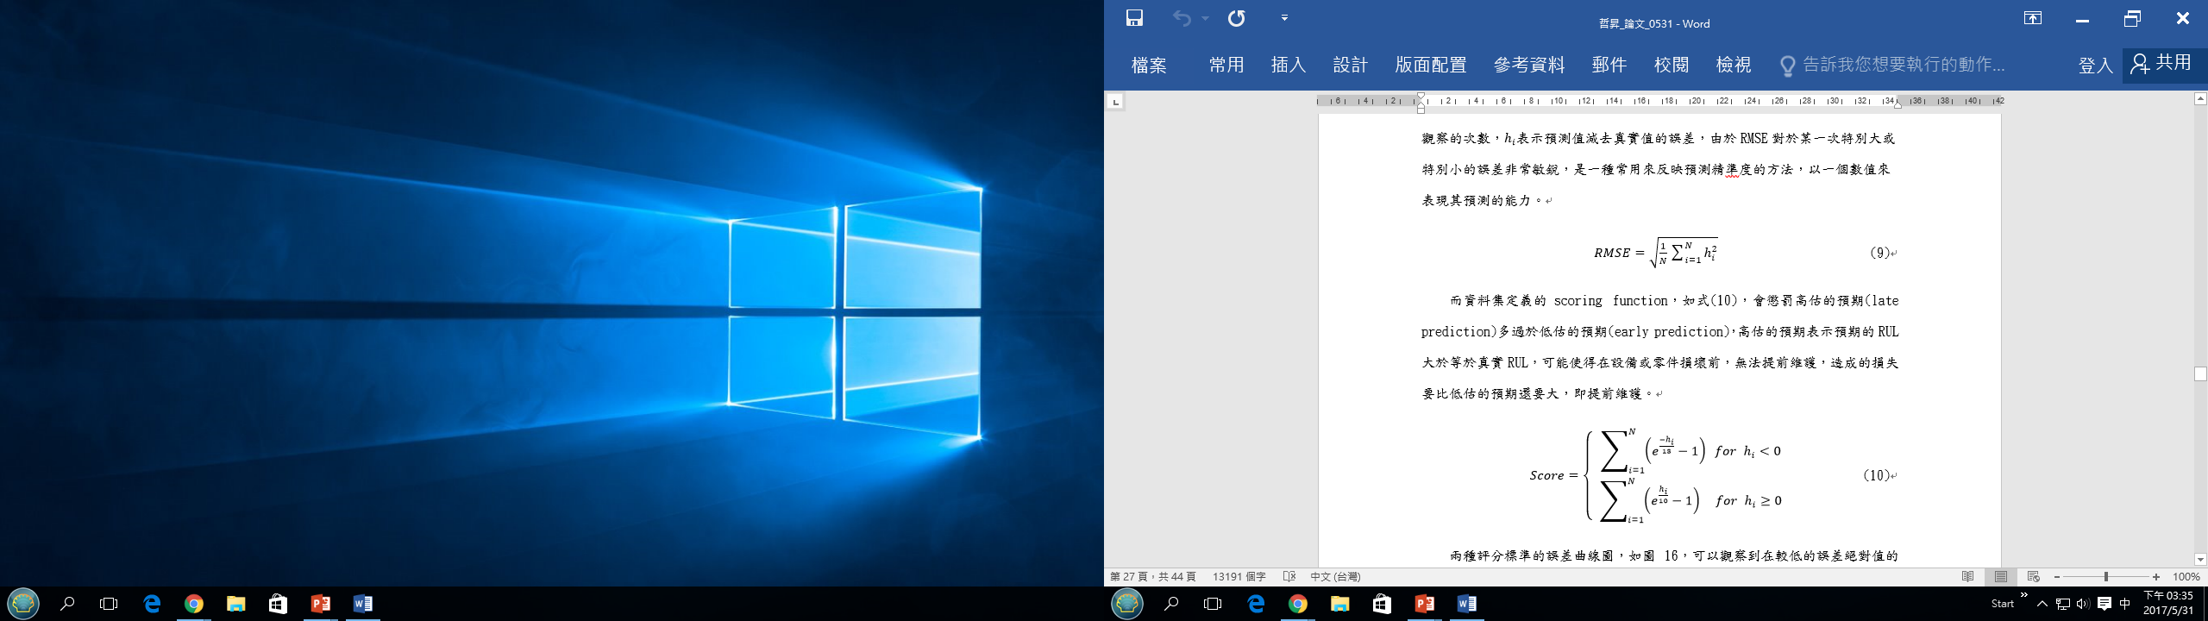
Metrics for NASA C-MAPSS
Notes:
hi: (estimated RUL – true RUL) for the ith engine
NASA C-MPASS

Slide 46
RMSE on NASA C-MAPSS Data Set
 | FD001 | FD002 | FD003 | FD004
MLP | 37.5629 | 80.0301 | 37.3853 | 77.3688
SVR | 20.9640 | 41.9963 | 21.0480 | 45.3475
RVR | 23.7985 | 31.2956 | 22.3678 | 34.3403
CNN | 18.4480 | 30.2944 | 19.8174 | 29.1568
ECNN | 19.5678 | 31.8743 | 20.7931 | 30.7983
LSTM | 16.7372 | 29.3308 | 18.0694 | 28.3958
Notes:
RMSE: root mean square error
Commercial Modular Aero-Propulsion System Simulations (C-MAPSS)

Slide 47
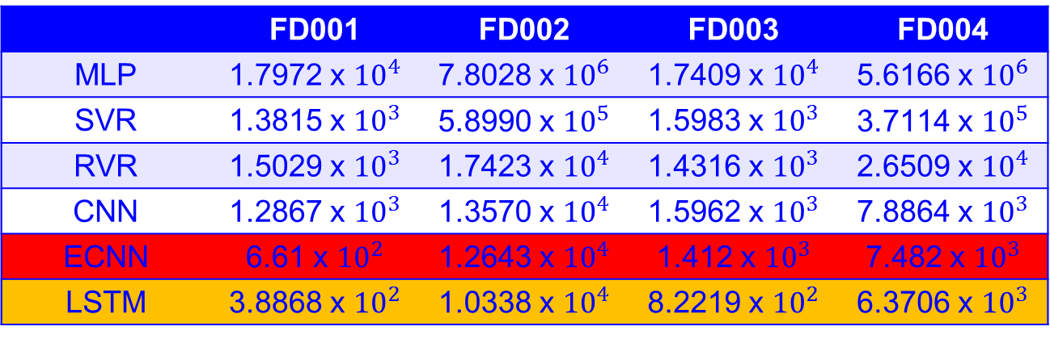
Scores on NASA C-MAPSS Data Set
 | FD001 | FD002 | FD003 | FD004
MLP | 1.7972 x ${10}^{4}$ | 7.8028 x ${10}^{6}$ | 1.7409 x ${10}^{4}$ | 5.6166 x ${10}^{6}$
SVR | 1.3815 x ${10}^{3}$ | 5.8990 x ${10}^{5}$ | 1.5983 x ${10}^{3}$ | 3.7114 x ${10}^{5}$
RVR | 1.5029 x ${10}^{3}$ | 1.7423 x ${10}^{4}$ | 1.4316 x ${10}^{3}$ | 2.6509 x ${10}^{4}$
CNN | 1.2867 x ${10}^{3}$ | 1.3570 x ${10}^{4}$ | 1.5962 x ${10}^{3}$ | 7.8864 x ${10}^{3}$
ECNN | 6.61 x ${10}^{2}$ | 1.2643 x ${10}^{4}$ | 1.412 x ${10}^{3}$ | 7.482 x ${10}^{3}$
LSTM | 3.8868 x ${10}^{2}$ | 1.0338 x ${10}^{4}$ | 8.2219 x ${10}^{2}$ | 6.3706 x ${10}^{3}$
Notes:
C-MAPSS data set is provided by NASA from simulation results, where each record has hundreds of time cycles
Test data has shorter time cycles, such as 22 time cycles

Slide 48
Outline
Big Data
Deep Learning
Deep Learning Techniques
Deep Learning Applications in Industry 4.0
Conclusion

Slide 49
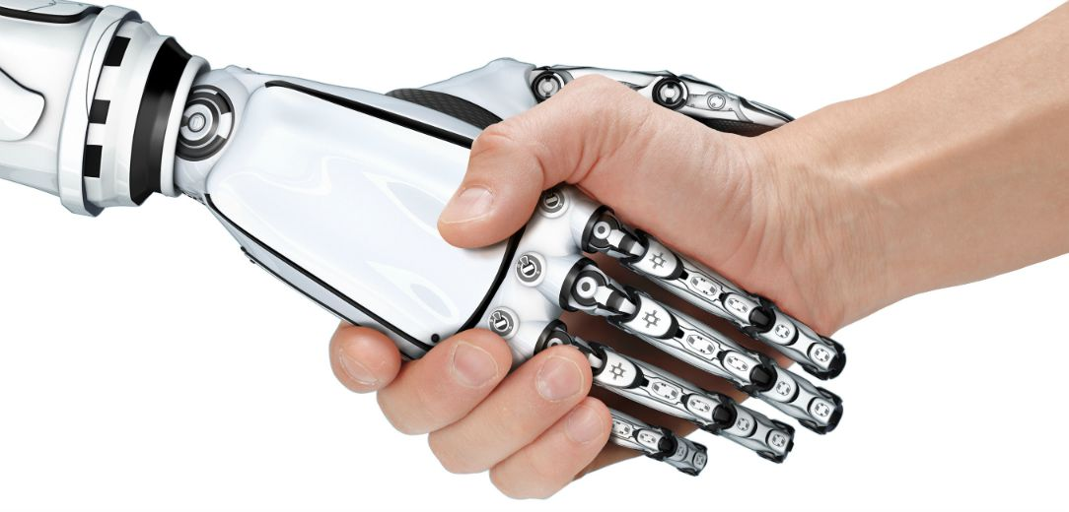
Conclusion
Deep learning technologies are changing the world in every application areas, including Industry 4.0 smart manufacturing.
“If you went to bed last night as an industrial company, you're going to wake up this morning as a software and analytics company” – Jeff Immelt, GE CEO, 2014.
Source: http://www.themanufacturer.com/articles/man-or-machine-robots-on-the-rise/

Slide 50
Thank You! jrjiang@g.ncu.edu.tw

